Slide 1

SMART ATTENDANCE SYSTEM USING COMPUTER VISION
A Project Report submitted to
Jawaharlal Nehru Technological University, Hyderabad.
In partial fulfillment for the requirement for the award of B.Tech Degree in Computer Science and Engineering
By
S . Vishnu Priya 17641A0558
T . Bindumathi 17641A0519
A .Sridhar Reddy 17641A0513
A . Chandu 17641A0533
Under the guidance of Mr. Shekar, Assistant Professor
DEPARTMENT OF COMPUTER SCIENCE & ENGINEERING VAAGDEVI COLLEGE OF ENGINEERING
(UGC Autonomous, Accredited by NBA, Accredited by NAAC with “A”)
Warangal - 506001
i

Slide 2
Team No : T26 Name of the project: SMART ATTENDANCE SYSTEM USING COMPUTER VISION
Abstract: The conventional attendance system requires manual marking of attendance, which is a time consuming process and hence is inefficient. So to digitalize the system, we have proposed an
automated student attendance system based on face recognition. Face is the representation of one’s
identity. Face recognition systems are very useful and powerful in applications especially in
security control systems in airports and crime investigations.
In our proposed approach, firstly, attendance marking is performed by activating the camera
through a user friendly interface. The system is built by five modules - Student Registration
(creating datasets and storing in a database), Training the model with the datasets, Face detection
and Recognition, Automatic Attendance Marking and Attendance Report Generation. The system is
built using OpenCV, Python and modules like tkinter for UI, openpyxl for automating excel, sqlite
database for storing datasets etc.,
The core of the project which is the face recognition can be used in many other applications where
face recognition is used for authentication.

Slide 3
Team No : T26 Name of the project: SMART ATTENDANCE SYSTEM USING COMPUTER VISION
Problem Statement: Maintaining attendance is essential in every foundation for checking the performance of students as well as employees. Each organization has its own technique. Traditionally a student's attendance is taken physically on the attendance register or sheet, given by the student in class. These stamping techniques are repetitive and tedious. An automatic attendance management system using biometrics would provide the needed solution. The results showed improved performance over the manual attendance management system. Biometric Based techniques have emerged as the most promising option for recognizing individuals in recent years since, instead of authenticating people and granting them access to physical and virtual domains.
Project Scope: The algorithm will be tested with multiple students in the scene and also captured faces at different angles in the scene. The algorithm delivers good results but there is room to improve the algorithm performance in case of large numbers of students and also in case of faces captured in a dark environment, and detect multiple faces at a time. The efficiency of the algorithm also can be increased further so there is also a room for future work in this area. This system can be enhanced further in terms of achieving more efficiency by ease of analysis of patterns in the data.

Slide 4
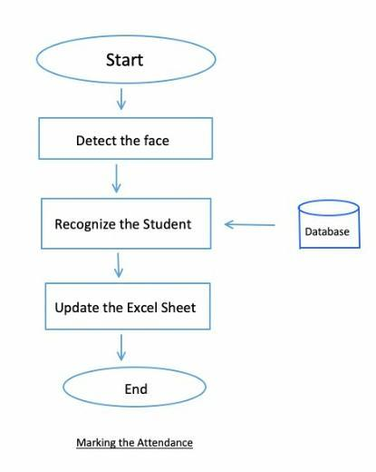
Team No: T26 Name of the project: Smart Attendance System using Computer Vision
Project Objective:
The main goal and objective of this Smart Attendance System using Computer Vision is to present face recognition in a real time environment to see and mark the attendance of their students and employees on a daily basis to keep track of their presence with the help of a database and generate attendance reports.
The main motive behind developing this system is to eliminate all the drawbacks, which were associated with manual attendance systems. The drawbacks ranging from wastage of time and paper, till the proxy issues arising in a class, are eliminated.

Slide 5
Team No: T26 Name of the project: SMART ATTENDANCE SYSTEM USING COMPUTER VISION
Software/ Hardware Requirements
a. Python
b. OpenCV framework
c. MS Excel and openpyxl library
d. SQLlite3
Application Areas:
Can be embedded in educational systems
Can be used in residential areas for security purpose
Can be used by employees in daily basis to keep track of their presence

Slide 6
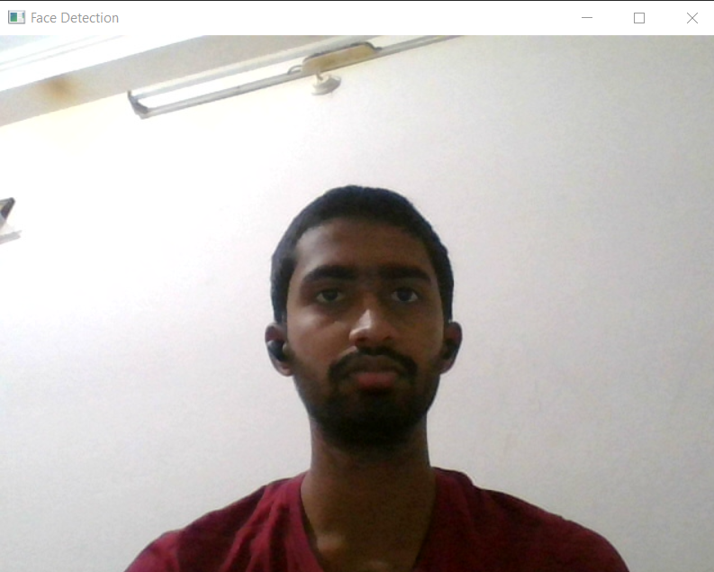
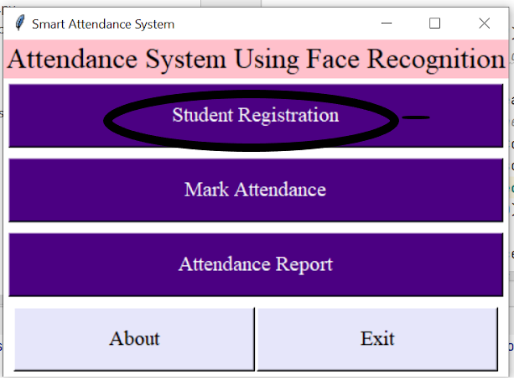
Team No: T26 Name of the project: Smart Attendance System using Computer Vision
Implementation of Module-1 : Student Registration
Software Environment Used : pycharm
Sub-modules: datasetCreator, trainer, UI
Major Functions used : cascadeclassifier, detectMultiScale
Number of lines of code : 110
Test cases for Module 1:
Input:

Slide 7
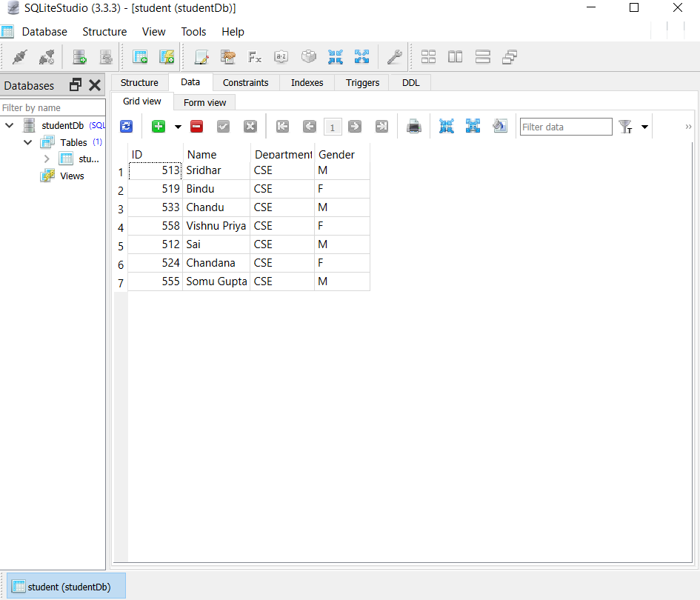
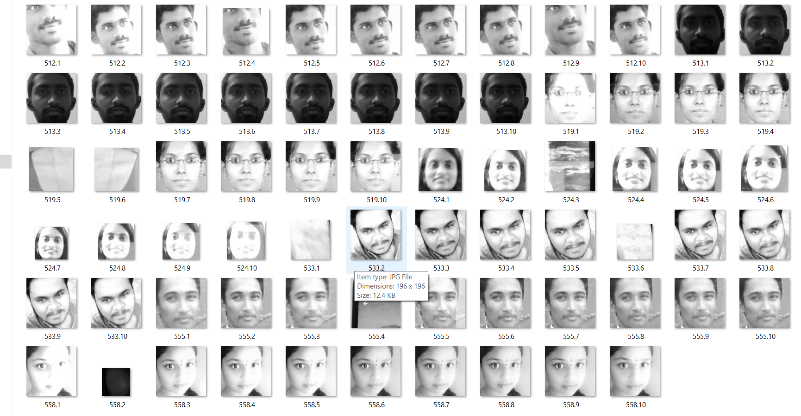
Team No : T26 Name of the project: Smart Attendance System using Computer Vision
Output : Database Reserve

Slide 8
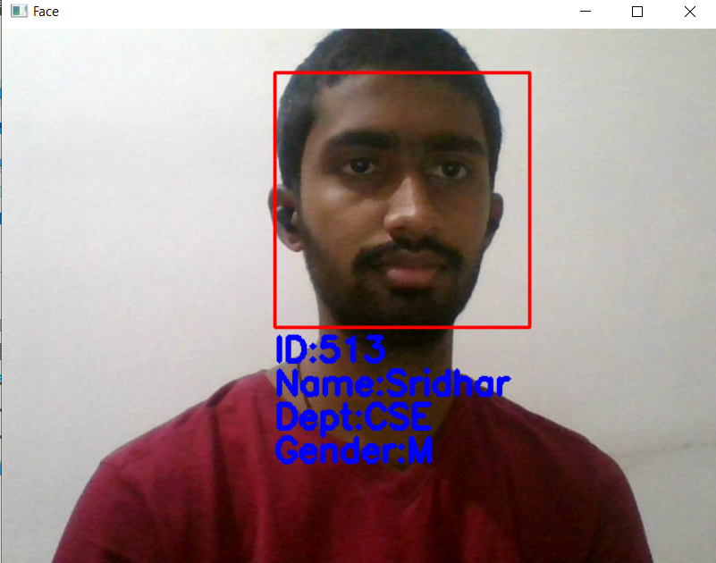
Team No: T26 Name of the project: Smart Attendance System using Computer Vision
Implementation of Module-2: Marking Attendance
Software Environment Used : pycharm
Sub modules : detector
Major Functions used : LBPH Algorithm
Number of lines of code : 66
Test cases for Module 2:
Test case1:
Input:
Output:

Slide 9

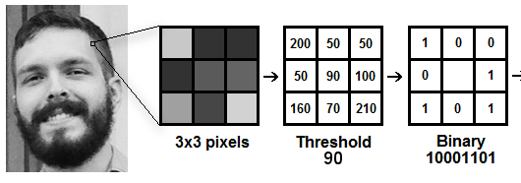
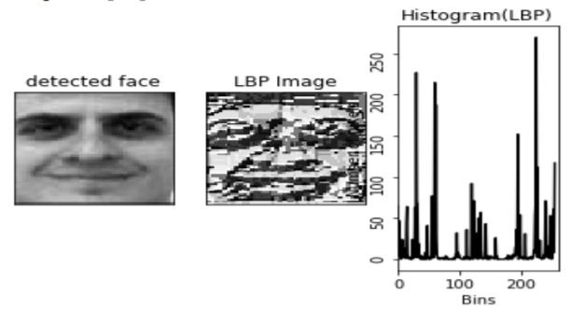
Team No: T26 Name of the project: Smart Attendance System using Computer Vision
Implementation of Module-2: Marking Attendance
LBPH Face Recognizer : Local Binary Pattern (LBP) is a simple yet very efficient texture operator which labels the pixels of an image by thresholding the neighborhood of each pixel and considers the result as a binary number.
 | 141
Integer 141
is Binary
10001101
The histogram vector is known as feature vector of the image. We compare the histograms of the test image and the images in the database and then we return the image with the closest euclidean distance histogram.

Slide 10
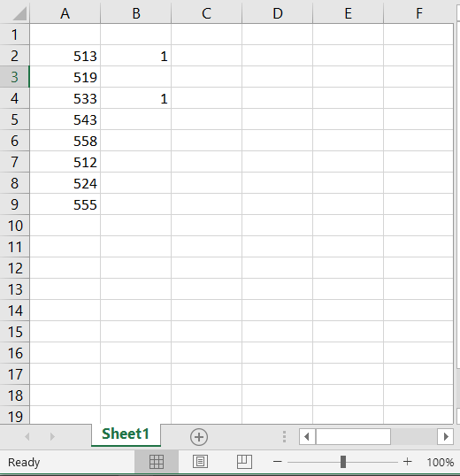
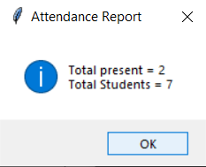
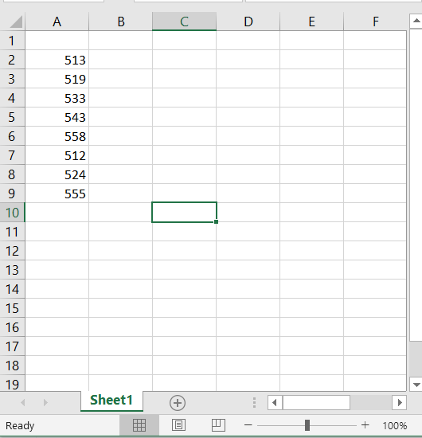
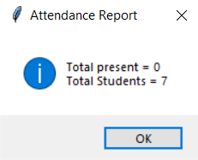
Team No: T26 Name of the project: Smart Attendance System using Computer Vision
Implementation of Module-3 : Attendance Reports
Software Environment Used : pycharm
Major Functions used : openpyxl library functions
Number of lines of code : 40
Test cases for Module 3:
Test case1: Excel Sheet
Input:
Output:
Test case2:
Input:
Output:

Slide 11
Team No : T26 Name of the project: Smart Attendance System using Computer Vision
Integration & Deployment
Technical challenges faced / Issues addressed
The inability of detect faces from a faraway distance.
The inability to detect in dim lightings because gray scale images are used.
Low performance in case of large number of students.

Slide 12
Team No : T26 Name of the project: Smart Attendance System using Computer Vision
Confusion Matrix for Accuracy : Accuracy = (TP+TN)/ (TP+TN+FP+FN)
On performing the accuracy test on 24 sample test images on 8 classes of images , the following is the confusion matrix
TRUE CLASS
True Positives
P/T Roll nos | 513 | 519 | 533 | 543 | 558 | 512 | 524 | 555
513 | 2
519 |  | 3
533 |  |  | 2 |  | 2
543 |  |  |  | 1
558 |  |  | 1 | 1 | 1 |  |  | 1
512 |  |  |  |  |  | 3
524 | 1 |  |  |  |  |  | 3
555 |  |  |  | 1 |  |  |  | 2
False Positives
PREDICTED CLASS
True Negatives
False Negatives
Accuracy (for each class) | (2+21)/24= 95.83 | 100 | (2+19)/24 = 87.5 | (1+21)/24= 91.66 | (1+18)/24= 79.16 | 100 | 100 | (2+20)/24= 91.66
Avg accuracy = (95.83+100 +87.5+91.66+79.16+100+100+91.66) /8 = 93.22%

Slide 13
Team No: T26 Name of the project: Smart Attendance System using Computer Vision
Conclusion & Future scope
Conclusion:
Maintaining the attendance is essential in every foundation for checking the performance of students as well as employee in terms of attendance percentage. The task to compute the attendance percentage becomes a major task as manual computation produces errors. So we would like to build a system which is both cost and time efficient and demands minimum voluntary action by the users for both taking attendance and making attendance reports in just one click.
Future Scope:
The algorithm will be tested with multiple students in the scene and also captured faces at different angles in the scene. The algorithm delivers good results but there is room to improve the algorithm performance in case of large numbers of students and also in case of faces captured in a dark environment, and detect multiple faces at a time. The efficiency of the algorithm also can be increased further so there is also a room for future work in this area. This system can be enhanced further in terms of achieving more efficiency by ease of analysis of patterns in the data.

Slide 14


